Slide 1

DELIVERY SWAB
Matteo Saglimbeni - Fabio Rossanigo 20/07/2022

Slide 2



OUR COMPANY
Delivery Swab is a company that handles the order, the home deliver and the test of swabs for customers who are unable to move from their houses. The customer selects the details of his order, a medical operator will be sent to perform the test and after some time the swab result will be received by a notification.

Slide 3
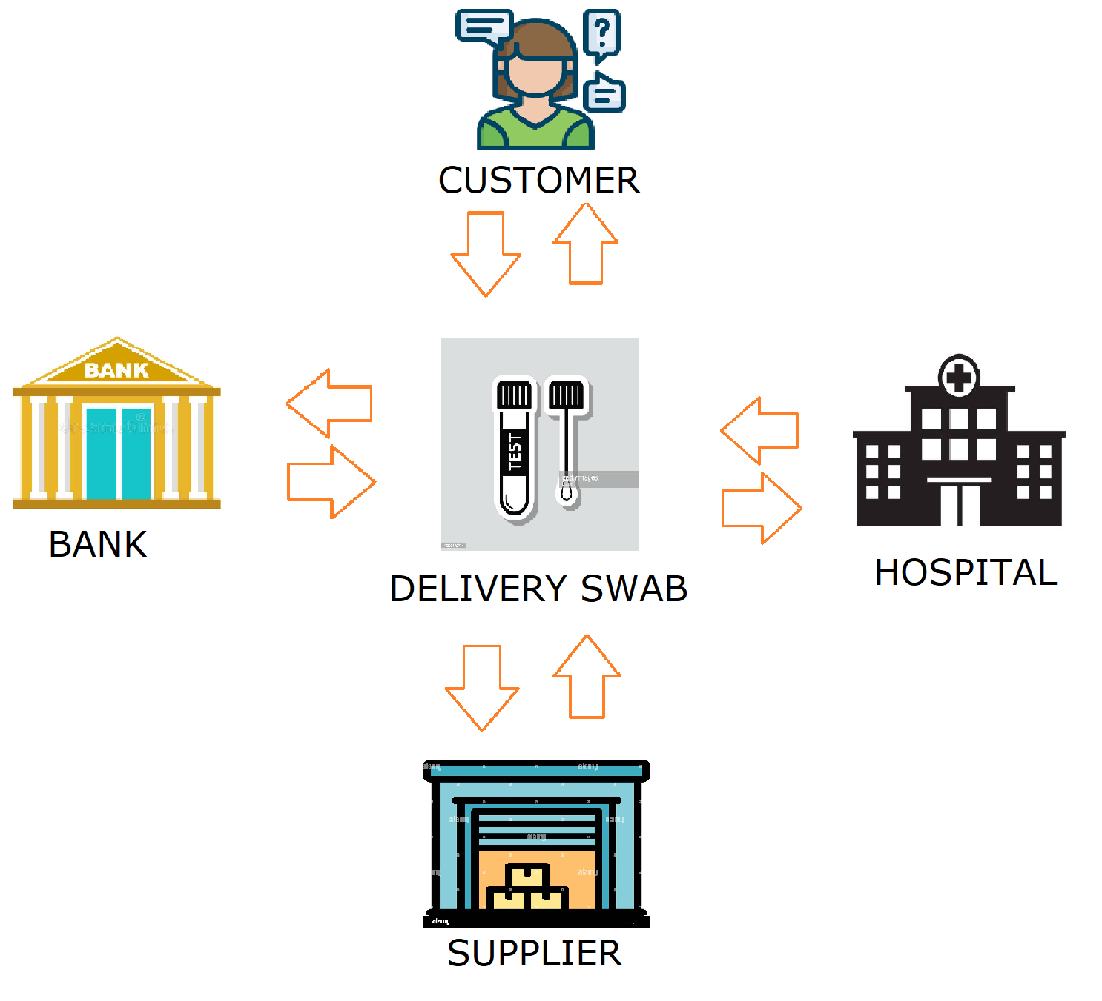
OVERVIEW

Slide 4
What have we done
ArchiMate modelling
ArchiMate is a language for enterprise architecture modelling used to the describe the various aspects and layers
Business Process Choreography & Orchestration
Choreography diagram defines the sequence of interaction among the participants. Each task is a step of interaction between two participants.
Orchestration diagram instead focuses on the lifecycle of the process.
Soundness checks
The Soundness check is a validation process that tells us if our process is in presence of behavioural anomalies, This is done by first converting the BPMN diagram in a petri net diagram.
Design and implementation of 3rd party API’s
API’s needed to manage the interaction with the external 3rd party services.
Executable Process
Executable simulation of the Delivery Swab process thanks to Camunda, Swagger tools and REST API.

Slide 5

Archimate model
ArchiMate is a language for enterprise architecture modelling to support the description analysis and visualization of the architecture within and across business domain.
The goal of the ArchiMate model is to define the process at high level of granularity, how the consumer is connected to the enterprise and how the processes are related

Slide 6
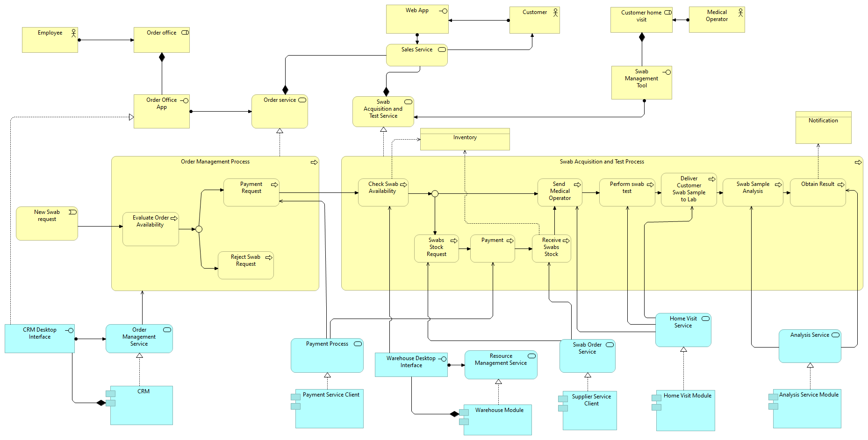
Archimate model( part I )
Our model consist of two main processes:
Order Management: which realizes the Order Service
Swab Acquisition and Test: realize the Swab Acquisition and Test service
The two services contribute to the composition of the Sales Service which il the main service of Delivery Swab.

Slide 7
Archimate model( part II )

Slide 8
Archimate model( full view )

Slide 9
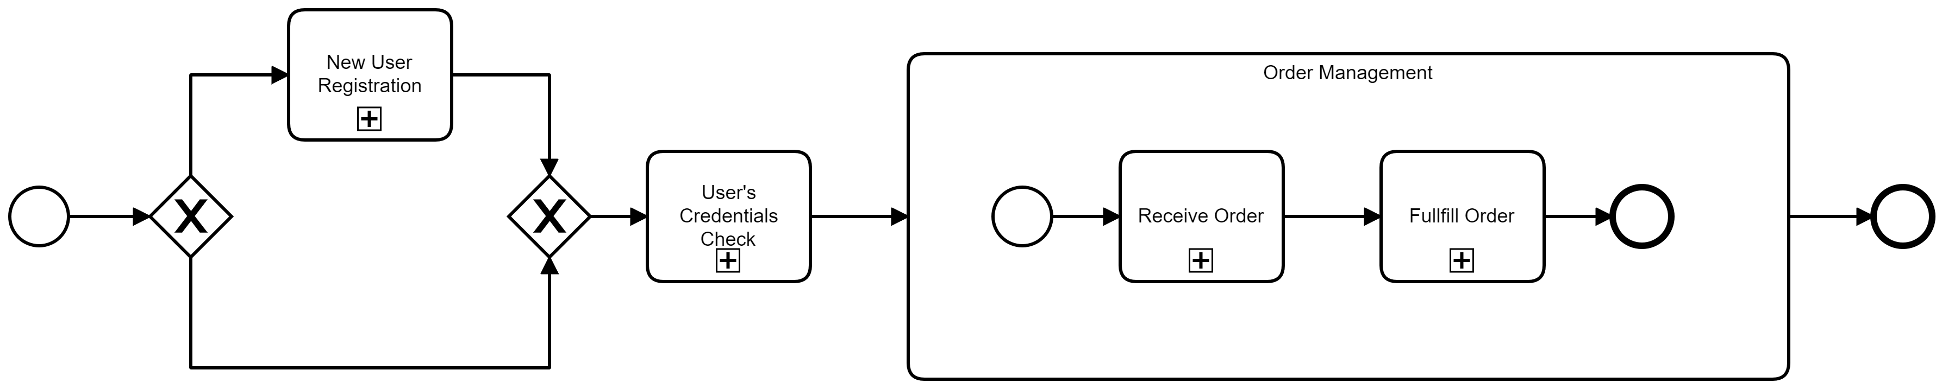
HIGH LEVEL Choreography & ORCHESTRATION
The main subprocesses of our company:
User Registration
User Credentials Check
Receive Order
Fulfill Order

Slide 10

choreography
The choreography diagram provides a high-level perspective focused only on the relationships among the organization, but without specifying the internal processes.
It does not take the standpoint of any of the participants and typically is the base from which the collaboration diagram is derived.

Slide 11
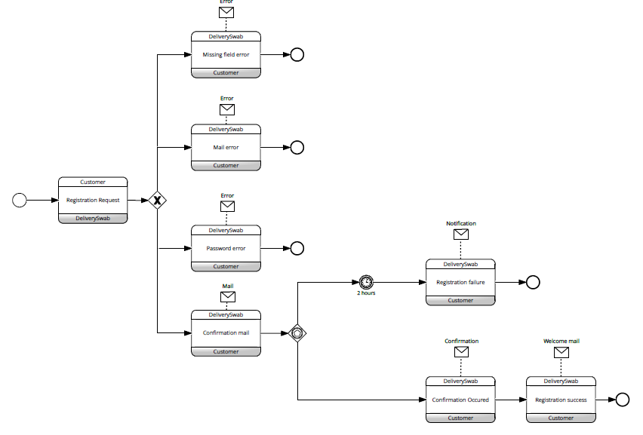
Choreography - User registration
The interaction begins with the receipt of the registration data from the customer.
If the data are correct then an email to confirm the registration is sent to the customer. The confirmation email contains a link that must be clicked by the user within two hours to complete the registration.
Following this, Delivery swab sends a registration confirmation email and a welcome email.

Slide 12
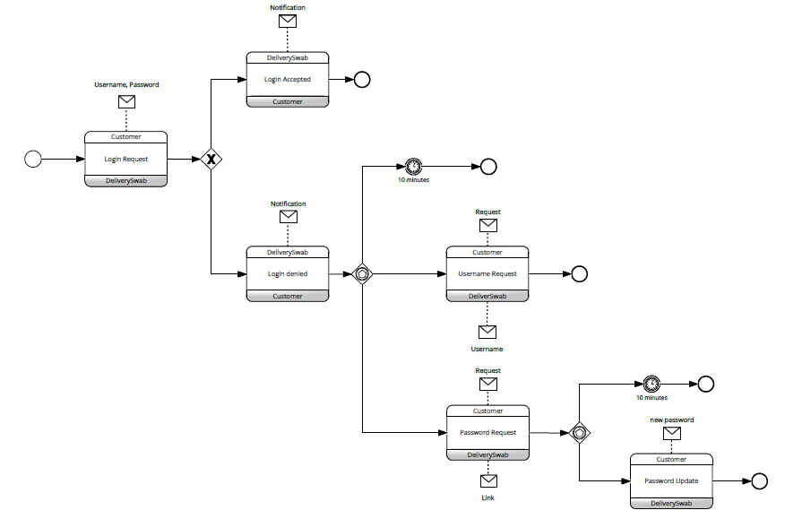
Choreography - User LOGIN
The interaction begins with the receipt of the login data from the user.
The outcome of the data verification is then sent to the customer.

Slide 13
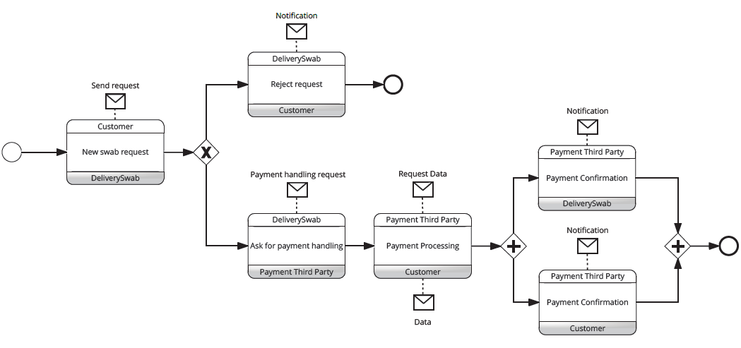
Choreography – receive order
The interaction begins with the receipt of the order data. Once received, the payment process takes place
through the exchange of messages between the company and the 3rd-party and between the 3rd-party and the user.

Slide 14
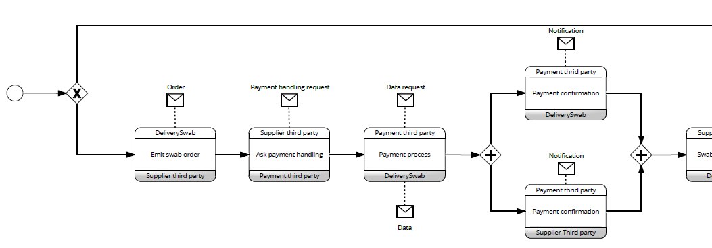
Choreography – fulfill order(part i)
The order is emitted. Then follows the actual payment of the Deliver Swab.

Slide 15
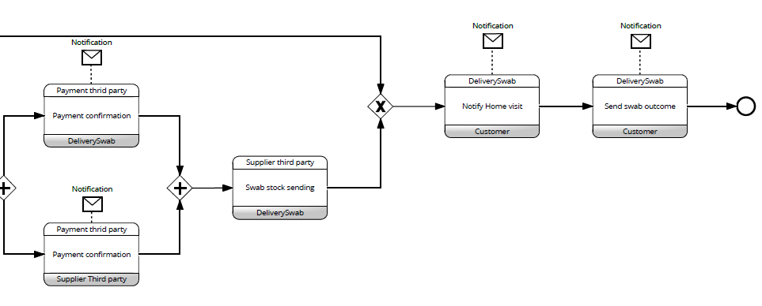
Choreography – fulfill order(part Ii)

Slide 16
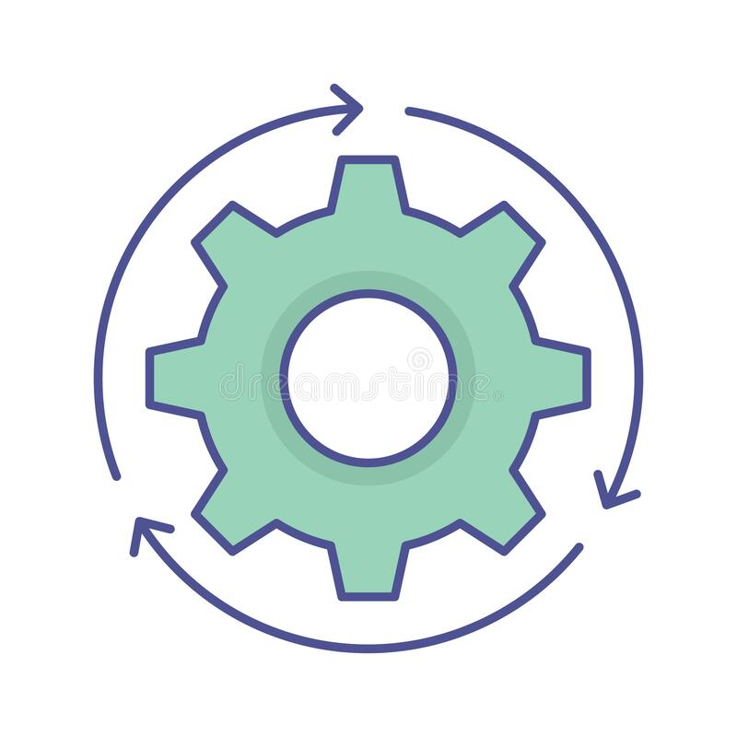
orchestration
Orchestration concerns the management of activities executed under a common controlling element (the orchestrator). Usually, the boundary of an orchestrator is an organization.
The orchestrator controls the execution of the business process according to a control-flow model. The control-flow is usually modelled based on a set of patterns.

Slide 17
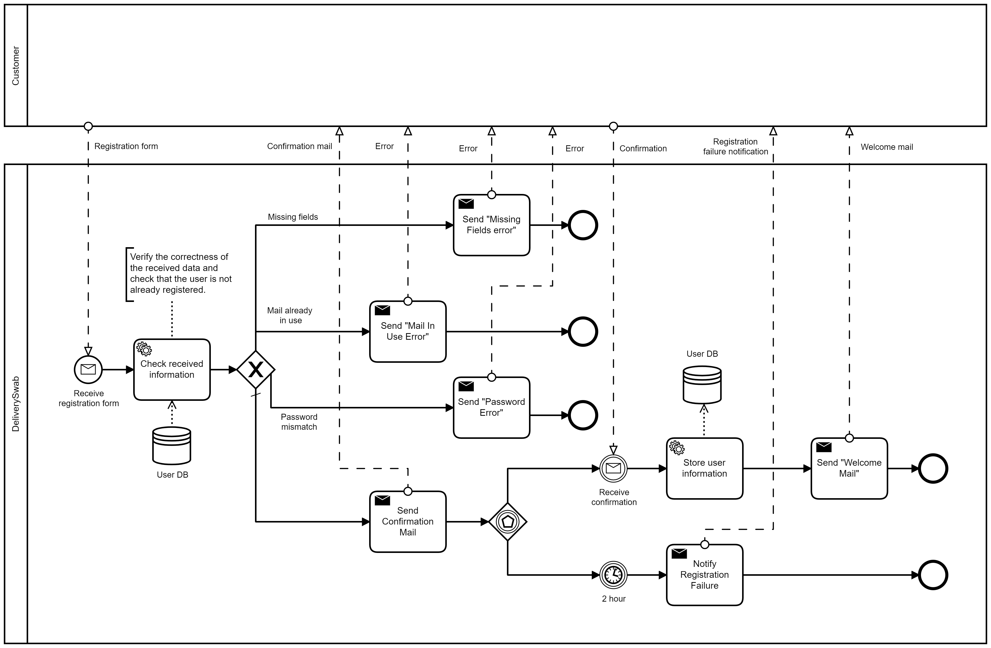
orchestration - User registration
During the registration we control of the correctness of the data.
The database is used both to verify the customer data and to memorize them when the registration is confirmed.

Slide 18
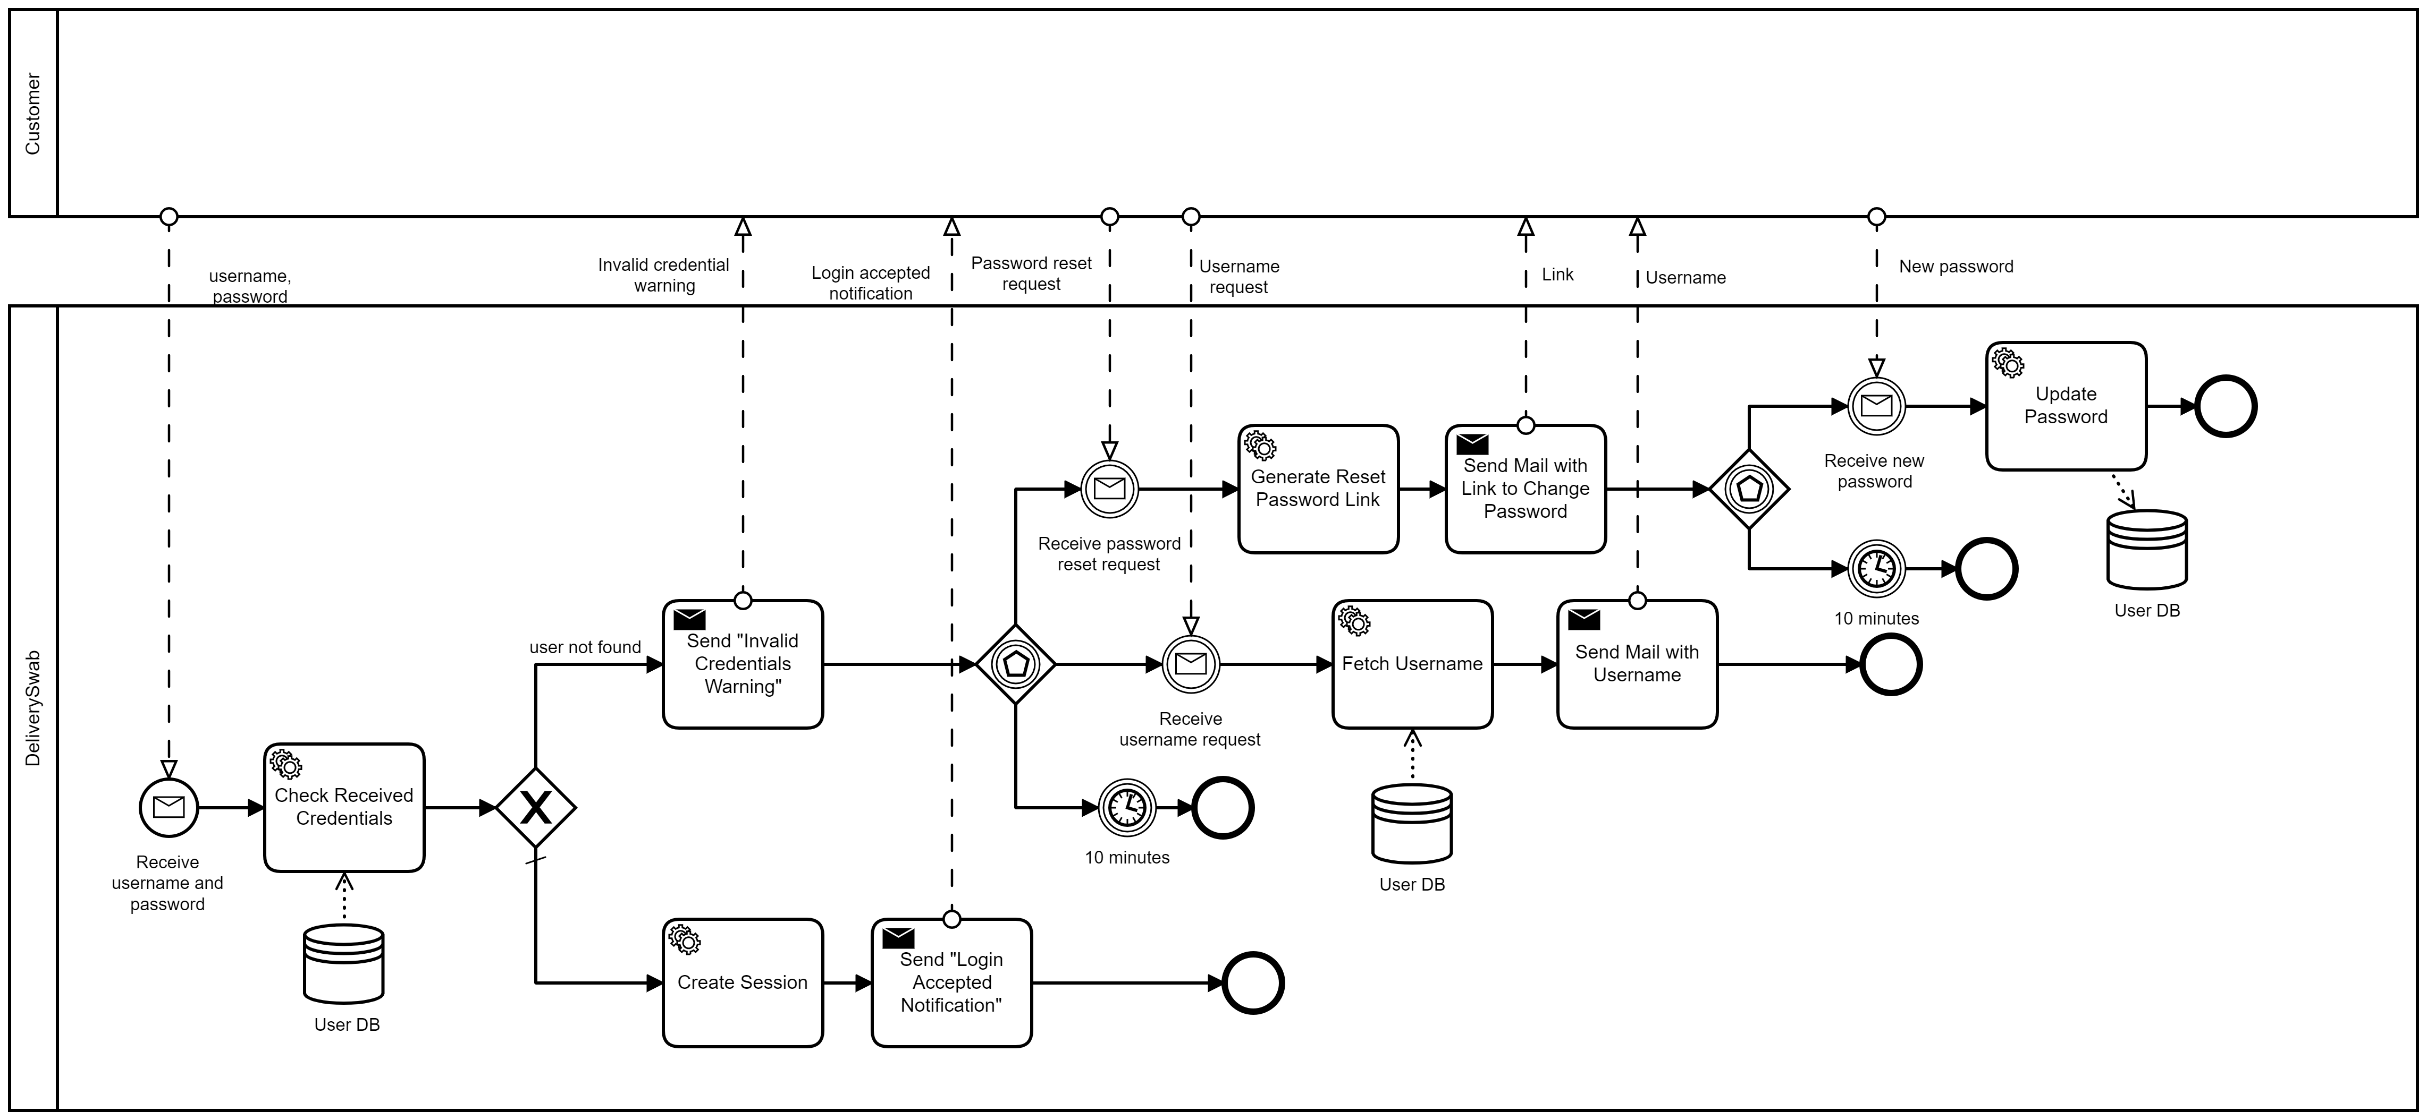
orchestration - User LOGIN

Slide 19
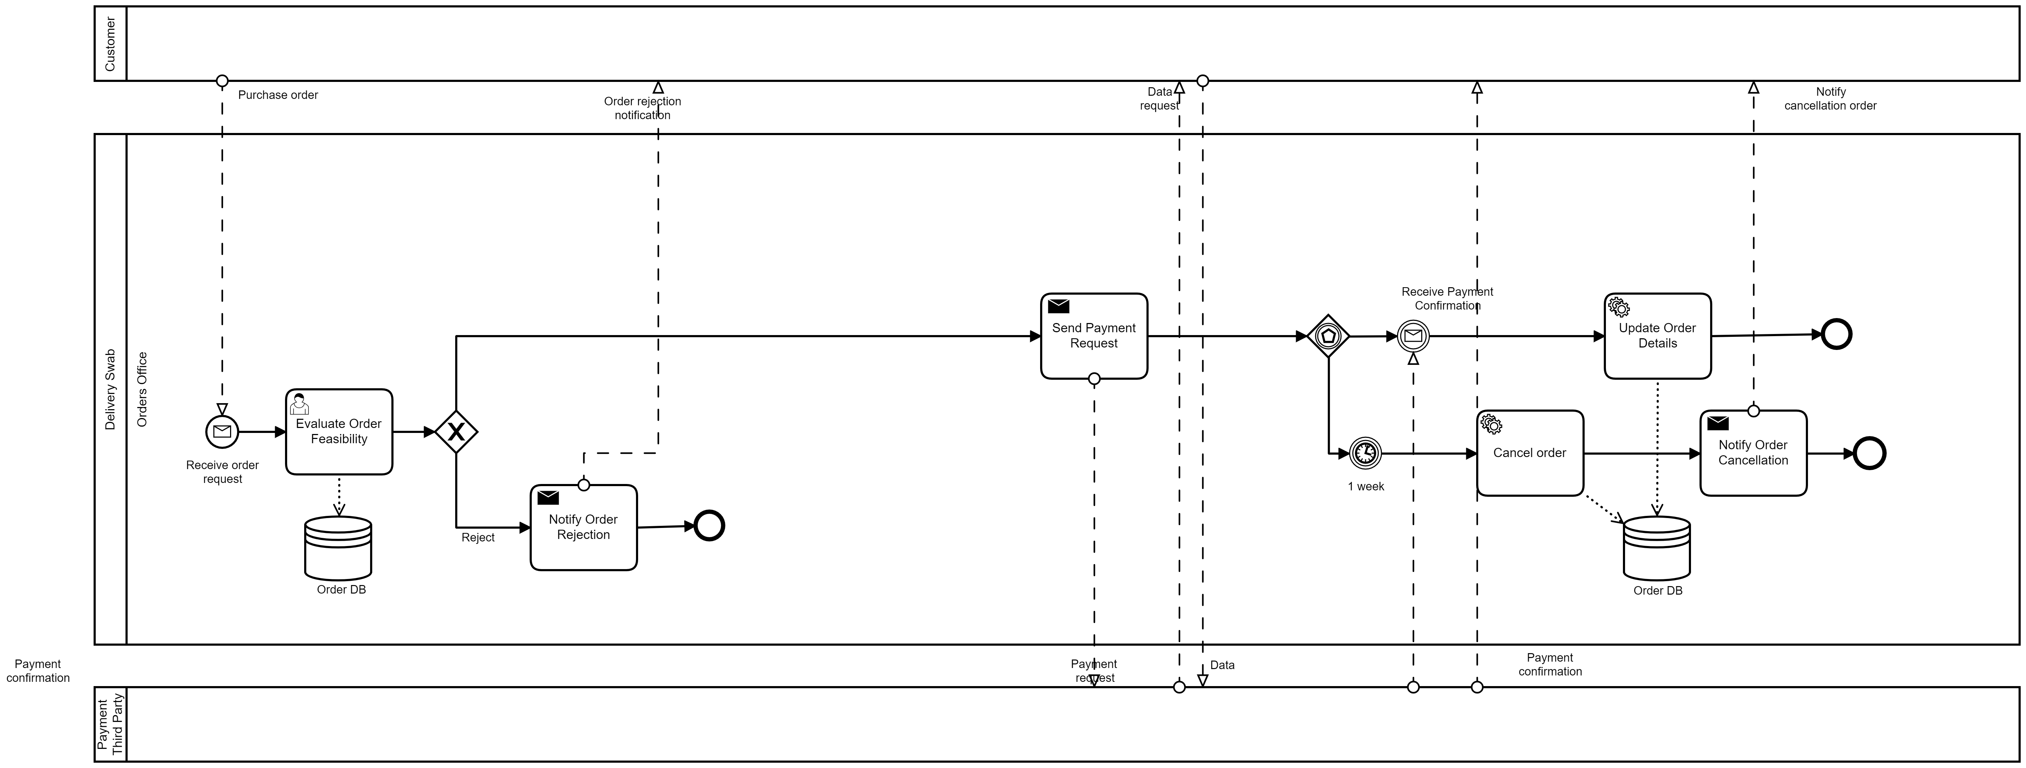
orchestration – receive order

Slide 20
orchestration – fulfill order (part I)
A service task verifies the availability of swabs. If the resources are not in stock, the company has to purchase swabs stocks before proceeding with the home visit.
Once the company has received the swabs, or if the swabs are already in stock, a set of user tasks, concerning the sending of the medical operator and swab test, are executed.

Slide 21
orchestration – fulfill order (part II)
After the swabs are finally available, the company send an home visit notification and a medical operator goes to customer house ready for performing a swab test. After the swab sample has been collected, the operator delivers it to a 3rd-party hospital that handles the analysis itself. When the swab outcome is ready, a notification is forwarded to the customer.

Slide 22
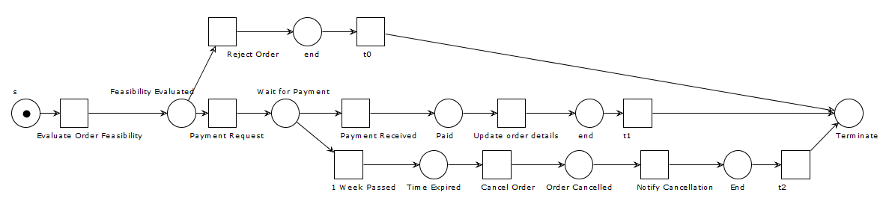
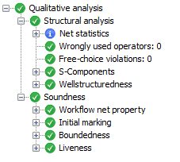
soundness
The soundness is a property that allow to identify correct WF-nets and so business processes.
A WF-Net (corresponding to a BP) is sound if and only if: for any case, the procedure will terminate eventually, and at the moment the procedure terminates there is a token in place ‘o’ (the final place) and all the other places are empty. The soundness is checked on the Receive Order phase.

Slide 23
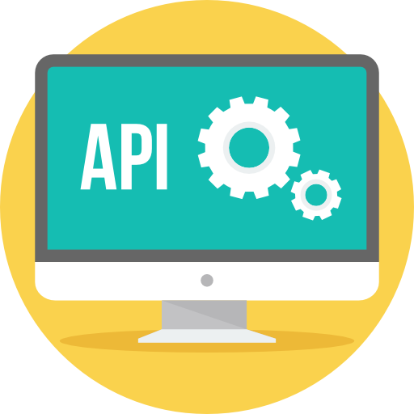
Rest api
An API is a set of definitions and protocols for building and integrating application software.
A REST API (also known as RESTful API) is an architectural style for an application program interface (API) that uses HTTP requests to access and use data. That data can be used to GET, PUT, POST and DELETE data types, which refers to the reading, updating, creating and deleting of operations concerning resources.

Slide 24
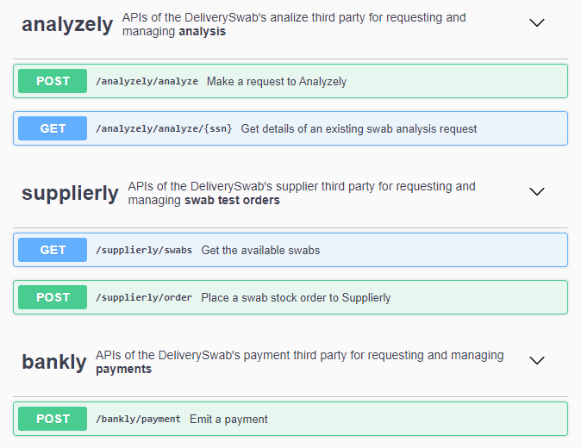
Rest api
We have three external services:
Analyzely(the Hospital): requesting and executing the swab analysis.
Supplierly(a swab supplier): requesting and managing swab orders.
Bankly(a bank): requesting and managing payments.

Slide 25
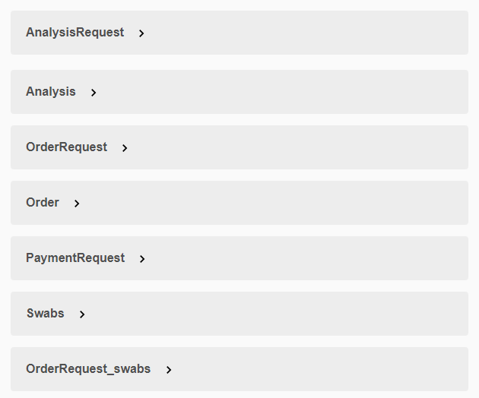
Rest api schemas
The majority of the exchanged messages are structured according to some schemas that we have defined.

Slide 26
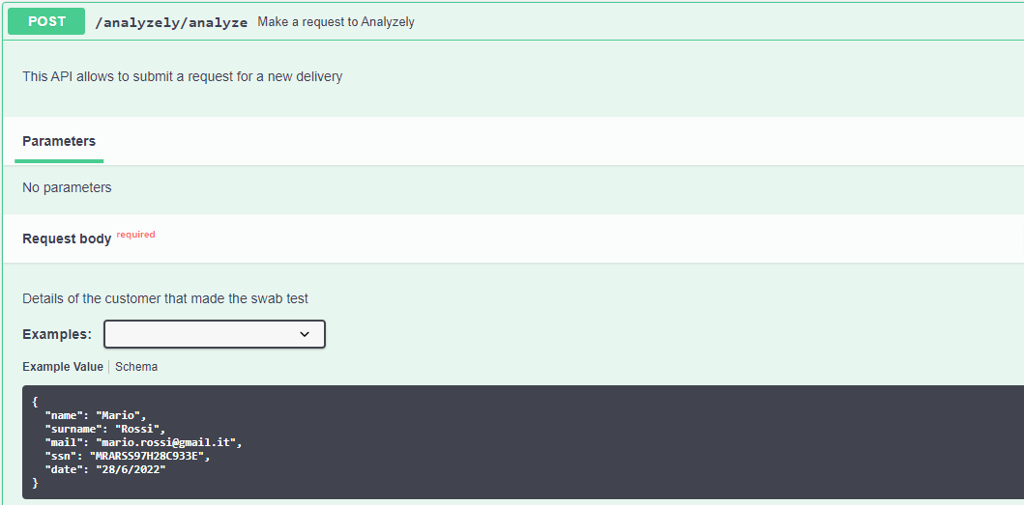
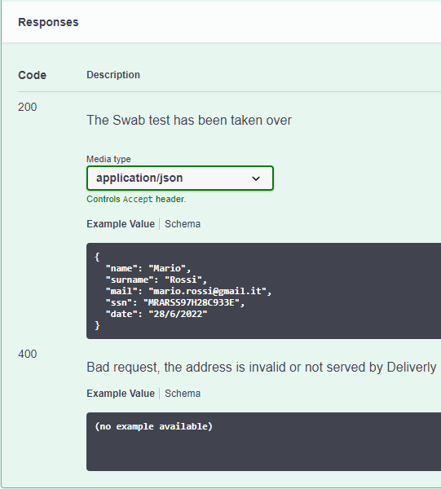
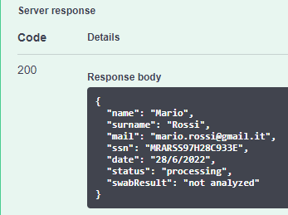
Post - Analyzely

Slide 27
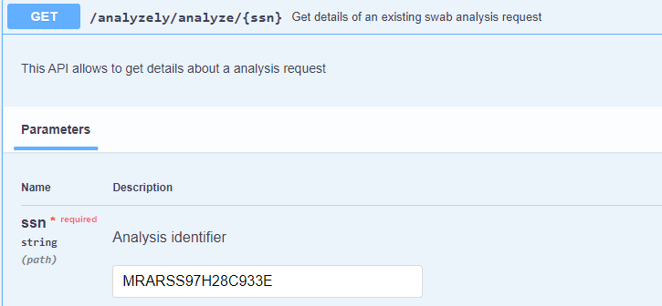
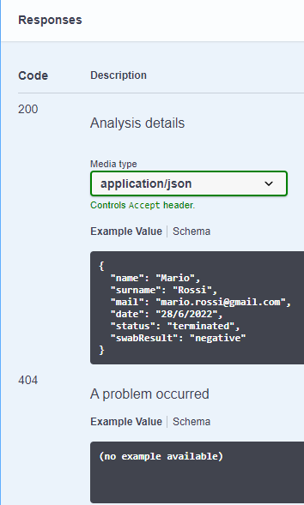

get - Analyzely

Slide 28
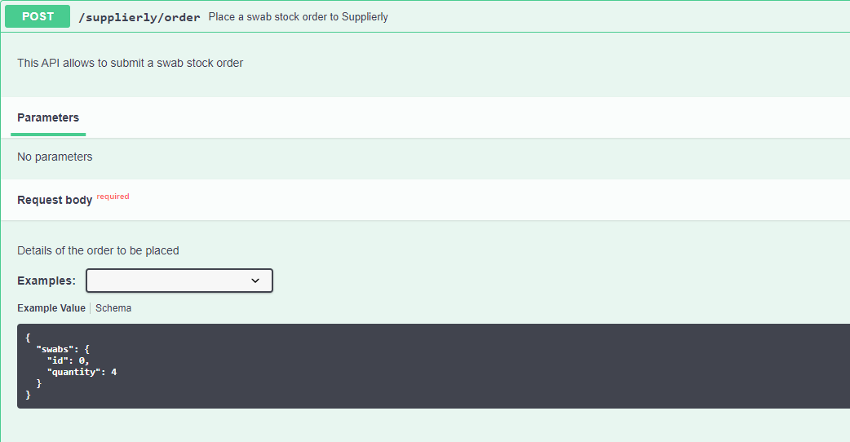
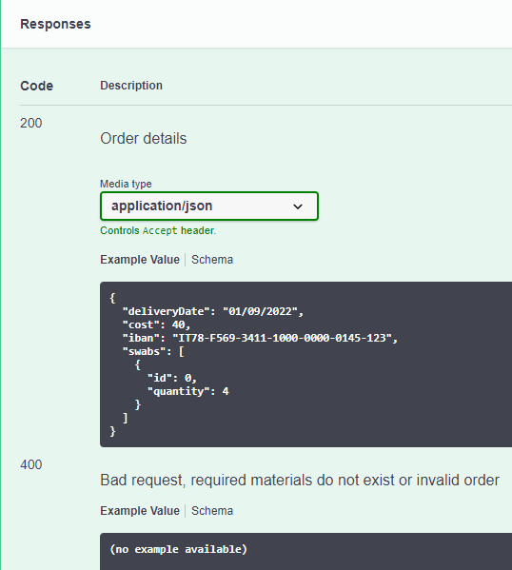
Post - supplierly

Slide 29
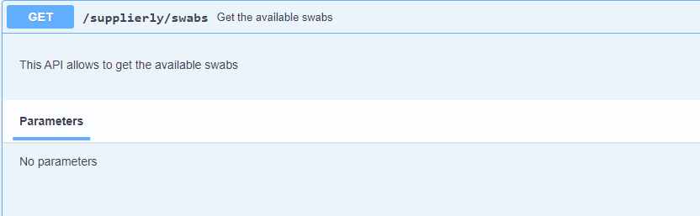
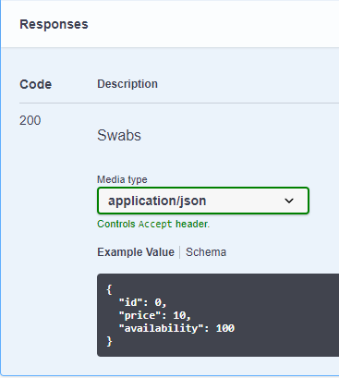

get - supplierly

Slide 30
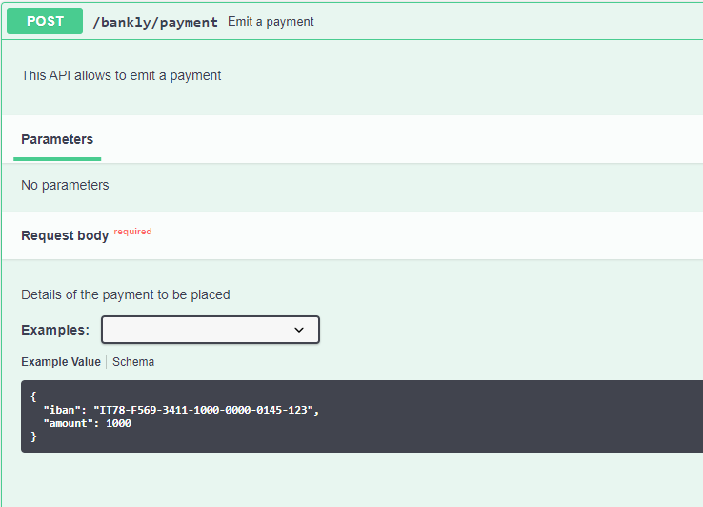
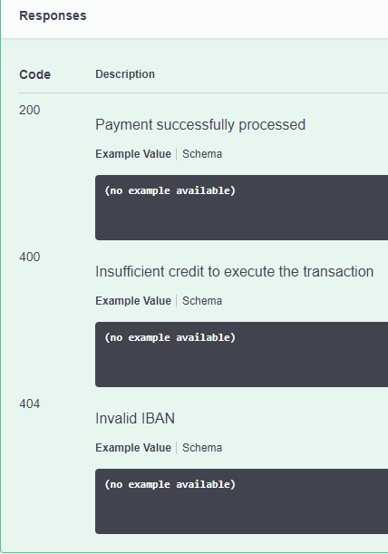
Post - bankly

Slide 31
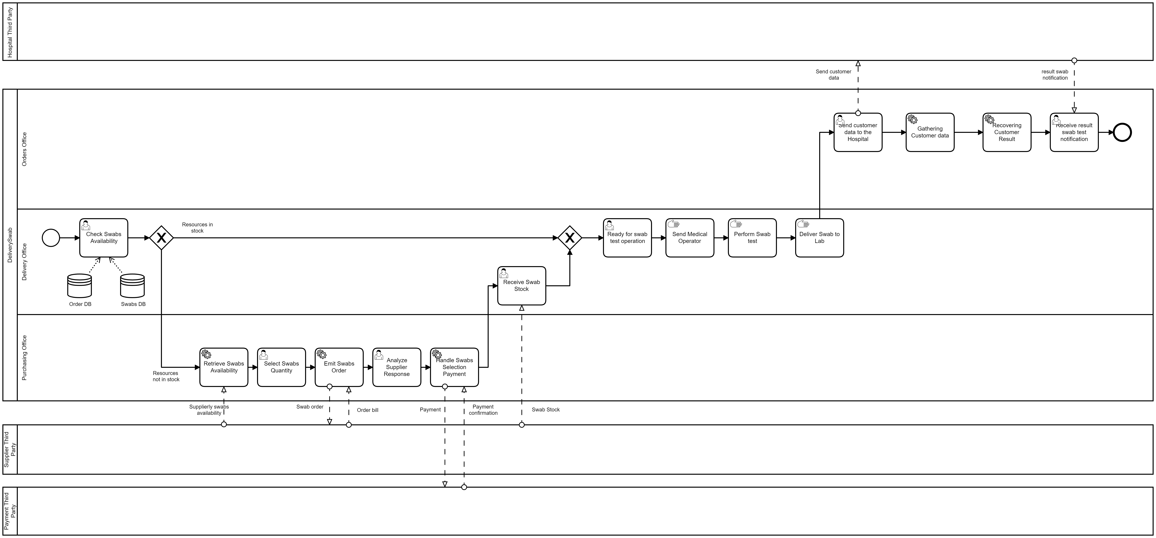
Implementation

Slide 32
DELIVERY SWAB
Thanks for your attention!
by

